Slide 1

CSCI-3753: Operating Systems Spring 2021
Biljith Thadichi
Department of Computer Science University of Colorado Boulder
Slides based on presentation by Abigail Fernandes

Slide 2
Week 5
> fork()
> Inter-Process Communication (IPC)
> PA2 questions
CSCI 3753 Spring 2021
3

Slide 3
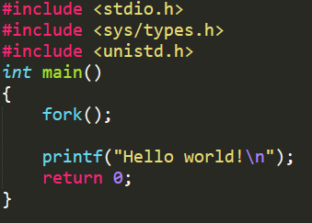
Fork - Easy
How many times is Hello world! printed?
CSCI 3753 Spring 2021

Slide 4

Fork - Easy
How many times is Hello world! printed?
Twice! You’re a beast. Keep going!
CSCI 3753 Spring 2021

Slide 5
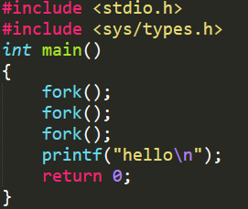
Fork - Medium
How many times is hello printed?
CSCI 3753 Spring 2021

Slide 6

Fork - Medium
How many times is hello printed?
8 times! Savage!
Tip: For n fork() calls, 2^{n}-1 child processes are created.
CSCI 3753 Spring 2021

Slide 7
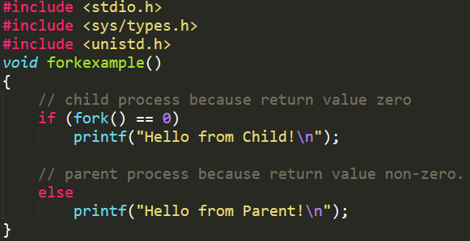
Fork - Easy
What is the output?
CSCI 3753 Spring 2021

Slide 8
Fork - Easy
What is the output?
Since the child and parent run concurrently, the order of output could change based on who gets to execute printf() first
CSCI 3753 Spring 2021

Slide 9
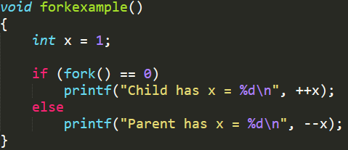
Fork - Medium
What is the output?
CSCI 3753 Spring 2021

Slide 10
Fork - Medium
What is the output?
Parent has x = 0 Child has x = 2
(or)
Child has x = 2 Parent has x = 0
CSCI 3753 Spring 2021

Slide 11
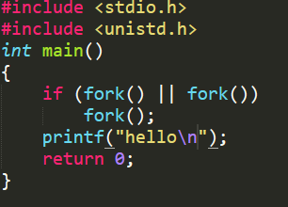
Fork - Hard
How many times is hello printed?
CSCI 3753 Spring 2021

Slide 12

Fork - Hard
How many times is hello printed?
5 times! You beautiful otherworldly creature!
CSCI 3753 Spring 2021

Slide 13
Week 5
> fork()
> Inter-Process Communication (IPC)
> PA2 questions
CSCI 3753 Spring 2021
3

Slide 14

Visual Metaphor
IPC is like working together in a toy shop
Workers share work area
Parts and tools on the table
Workers call each other
Explicit requests and responses
Requires synchronization
I’ll start when you finish
CSCI 3753 Spring 2021

Slide 15
Visual Metaphor
IPC is like working together in a toy shop
Processes share memory
Data in shared memory
Processes exchange messages
Message passing via sockets
Requires synchronization
Mutexes, waiting
Workers share work area
Parts and tools on the table
Workers call each other
Explicit requests and responses
Requires synchronization
I’ll start when you finish
CSCI 3753 Spring 2021

Slide 16
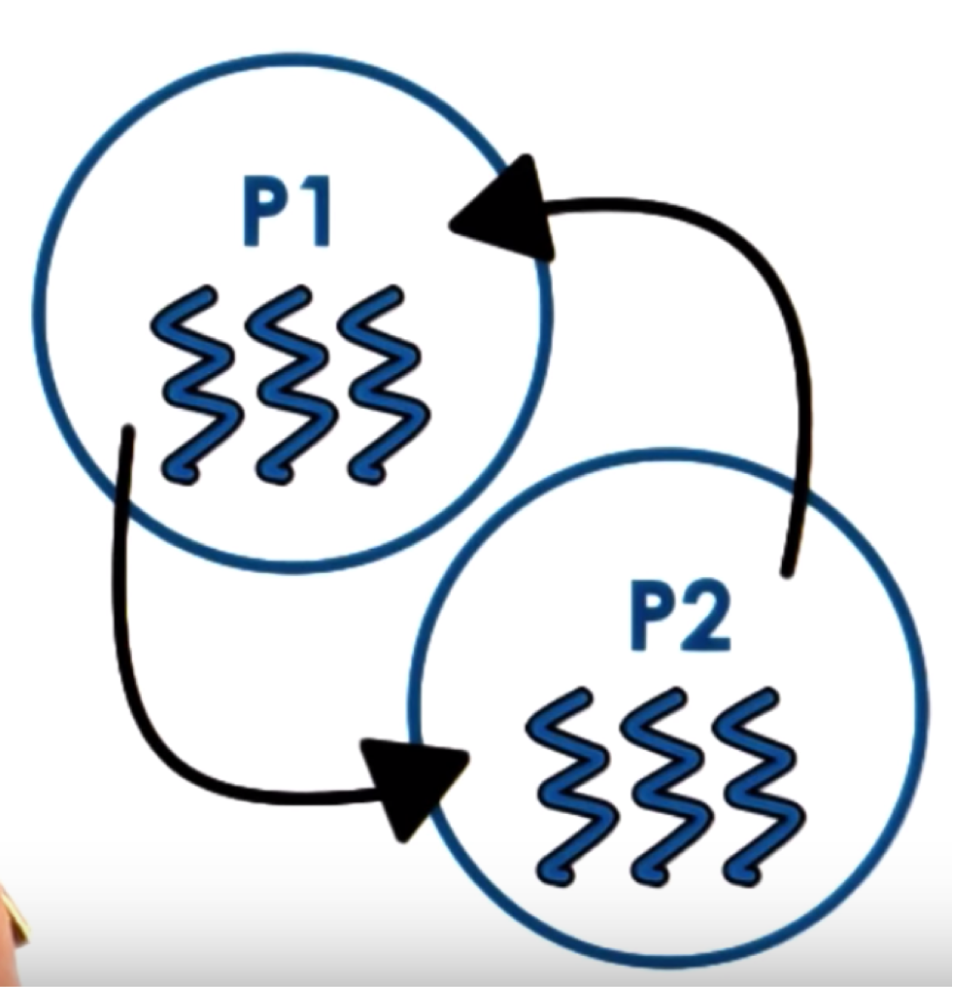
Inter Process Communication
IPC = OS supported mechanisms for interaction amongst processes (co-ordination and communication)
Message Passing
Sockets, pipes, message queues
Memory Based IPC
Shared memory, memory mapped files
Higher level semantics
Files, RPC
Synchronization primitives
Signals, interrupts
CSCI 3753 Spring 2021

Slide 17
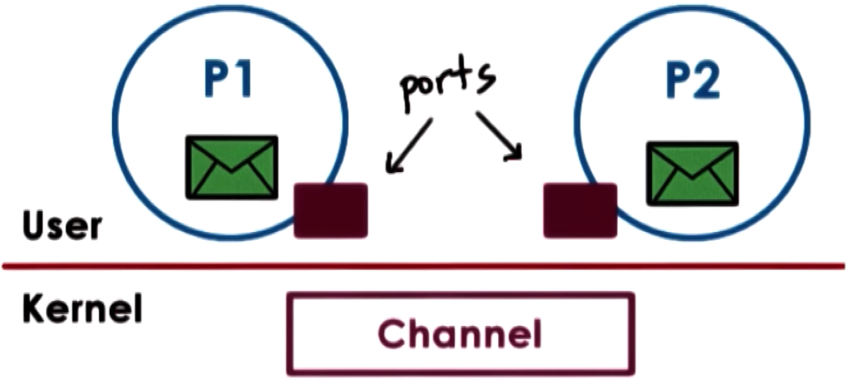
Message Passing
Send / Receive messages
OS creates and maintains a channel
Buffer, FIFO queue
OS provides an interface to the process
A port
Processes send/write messages to a port
Processes receive/read messages from a port
CSCI 3753 Spring 2021

Slide 18

Message Passing
Kernel required to
Establish communication
Perform each IPC operation
Send: System call+ data copy
Receive: System call + data copy
CSCI 3753 Spring 2021

Slide 19
Message Passing
How many user/kernel crossings needed to send a request and receive a response?
CSCI 3753 Spring 2021

Slide 20
Message Passing
How many user/kernel crossings needed to send a request and receive a response?
Answer: 4x user – kernel crossings + 4 data copies.
CSCI 3753 Spring 2021

Slide 21
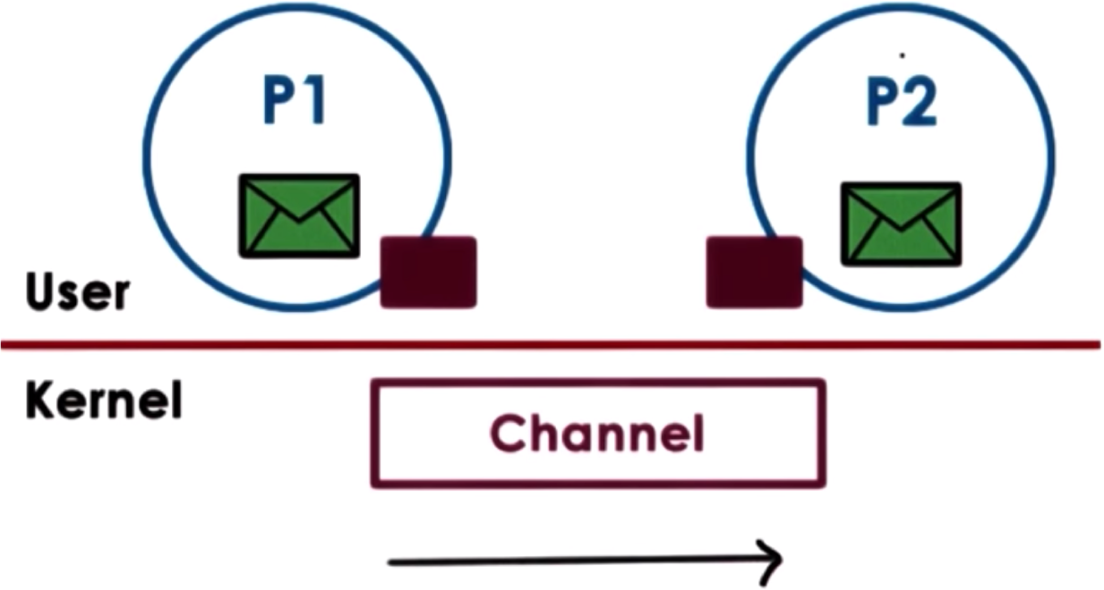
Message Passing (Pipes)
Pipes
Carry byte stream between 2 processes.
Eg. Connect output from one process to input of another.
Unidirectional in nature
Data written to the write end of the pipe is buffered by the kernel until it is read from the read end of the pipe.
CSCI 3753 Spring 2021

Slide 22



Message Passing
Overheads
Time Consuming
Simplicity: Kernel does channel
management and synchronization
CSCI 3753 Spring 2021

Slide 23
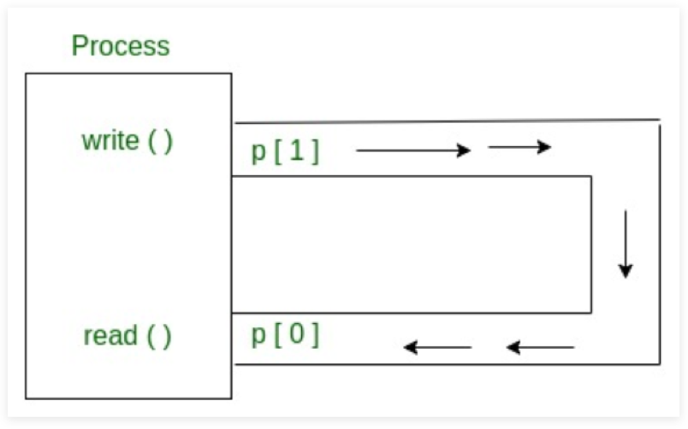
Linux Pipes
A pipe is created using the pipe() system call:
int pipe(int fildes[2]);
Parameters :
fd[0] will be the fd (file descriptor) for the read end of pipe.
fd[1] will be the fd for the write end of pipe.
Returns :
0 on Success.
- 1 on Error.
CSCI 3753 Spring 2021
23

Slide 24
















Pipe Example (Code Demo)
Main Process
mcpipe2[1]
Messages are streams of numeric
mcpipe1[1]
data
“Square” file
“Cube” file
Pipe 2
Pipe 1
mcpipe2[0]
mcpipe1[0]
Child Process 2
Child Process 1
CSCI 3753 Spring 2021
24

Slide 25
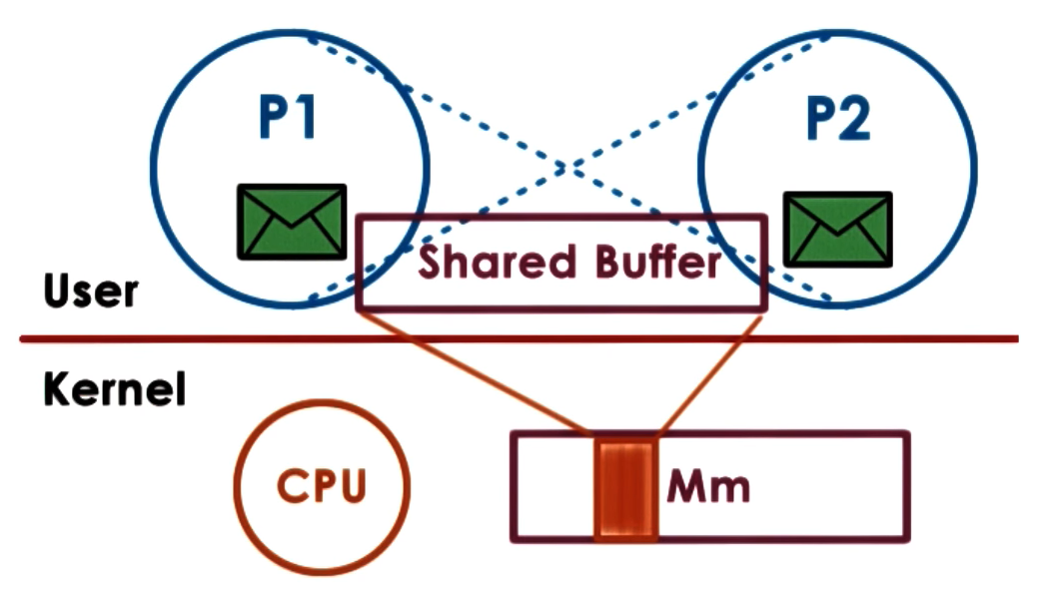
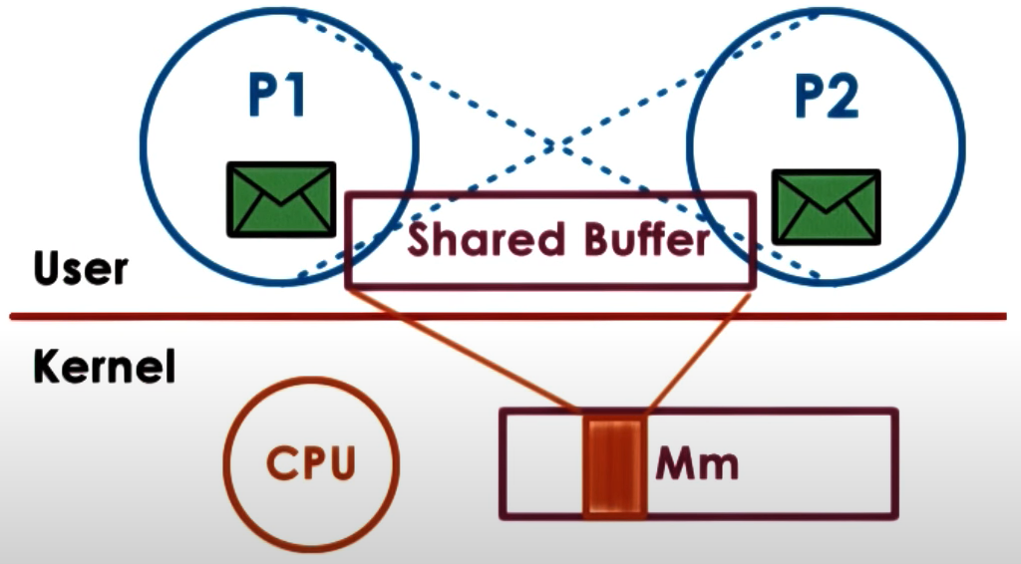
Shared memory
Read / Write to Shared Memory
OS establishes the channel
Different virtual addresses mapped to the same physical address
CSCI 3753 Spring 2021

Slide 26
Shared memory
Explicit synchronization
Shared buffer management and communication protocol is programmer’s responsibility
System calls only for setup
Large amounts of data can be exchanged
CSCI 3753 Spring 2021

Slide 27
Shared Memory
Create a shared memory segment or get the ID of an existing shared segment
int shmget(key_t key, size_t size, int shmflg);
Other processes (if permitted) can access.
Library: sys/ipc.h and sys/shm.h
key: a value used to share between processes
size: size of the shared memory segment
shmflg: options for segment creation
CSCI 3753 Spring 2021

Slide 28
Shared Memory
Attach the shared segment to a process address space
void *shmat(int shmid, const void *shmaddr,…
int shmflg);
Once attached, a process can read or write to the segment.
Library: sys/types.h and sys/shm.h
shmid: id of the shared memory segment
shmaddr: address in the process space
shmflg: options for shared memory permission
CSCI 3753 Spring 2021

Slide 29
Shared Memory
Detach the shared memory segment located at the
shmaddr address
int shmdt(const void *shmaddr);
Library: sys/types.h and sys/shm.h
shmaddr: attaching address in the process space
CSCI 3753 Spring 2021

Slide 30








Shared Memory Example
Process SERVER
Write
Process CLIENT
Read
Code
Code
Data
Data
shmaddr
shmaddr
Heap
Heap
Key = 5678
Key = 5678
Stack
Shared Memory
Stack
CSCI 3753 Spring 2021

Slide 31
Week 5
> fork()
> Inter-Process Communication (IPC)
> PA2 questions
CSCI 3753 Spring 2021
3

Slide 32

Week 5 – Checklist
Complete this week’s quiz
Work on PA2
Practice fork() questions here
Go through the shared memory and pipe examples
Have a great weekend!
CSCI 3753 Spring 2021
17

